Slide 1
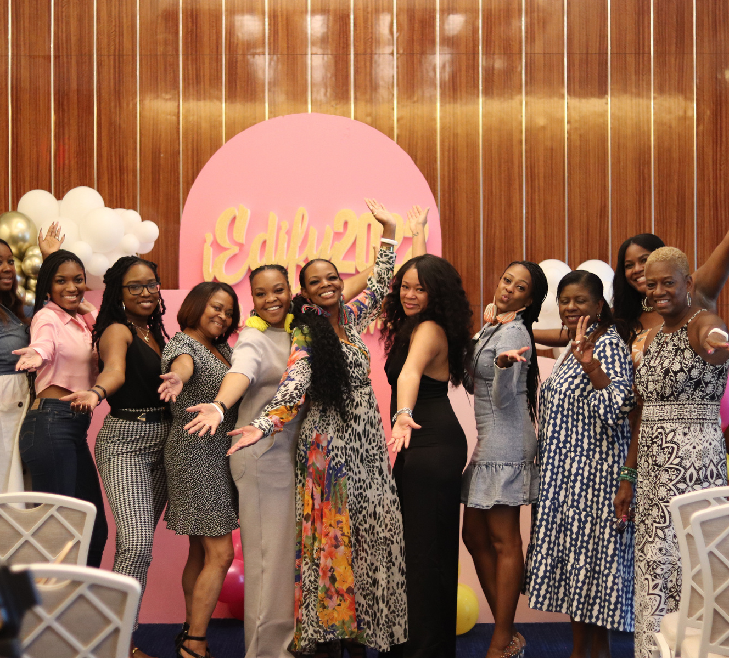
iEdify Womens Summit
PARTNERSHIP DECK
2023

Slide 2
AN EDIFIED WOMAN CAN DO ANYTHING!

Slide 3
WHO WE ARE..
AND WHY ARE..
iEdify Womens Summit is an annual 3-Day Conference for women who desire growth and transformation through practical teaching, genuine sisterhood (community) and a good time that gives them a moment to escape from the high demands of life and produce momentum in every area of their lives!
​
.
​ To help women transform their lives from the inside out and thrive in their God given purpose.

Slide 4
IEDIFY 5 THRIVING POINTS
OUR FOUNDATIONAL PRINCIPLES
Thriving
Mentally
Thriving
Physically
Thriving
Spiritually
Thriving Financially
Thriving
Relationally

Slide 5
Testimonials
"The IEdify 2018 and 2019 conference was absolutely amazing! It was so awesome to be surrounded by God fearing like-minded women who truly want healing and empowerment for other women. At the conference I was able to self-reflect and have real conversations, sharing my life experiences. I felt understood and supported! I cannot wait for the next conference!"
-Stacy G.
"A Safe Place - iEdify was truly a time of inspiration and sisterhood. I enjoyed the opportunity to share and encourage other women. Honestly, I was apprehensive about even speaking to other sisters due to my own insecurities and walls before. But, I thank God for this conference. It encouraged me to: be open for once, to realize that I am not perfect but loved by someone who is, and seek to build up other sisters who may be thinking the exact same why that I have thought about myself for years. I would definitely attend again and bring a friend."
~Cami
"Attending iEdify events the past two years has been such an awakening experience. I had the opportunity to connect with women who are game changers. It’s a safe haven to gather together with dynamic women and I get to take away love, business advice and encouragement. I have learned the true meaning of edification."
-B. Genel
"Life changing."
-anonymous

Slide 6
DEMOGRAPHICS
Household Annual income
Age Group
65k -100k+
13%
25k-45k
11.1%
40
30
20
10
0
45k -65k
75.9%
18-25
25-35
40+

Slide 7
OUR SOCIAL PRESENCE
Combined Social Media Following
15k+
Email List
500
iEdify Women Summit
Average attendance 60 attendees
We are iEdify
iEdify Women

Slide 8
SPONSORS

Slide 9
Thank You for being here!
I LOOK FORWARD TO PARTNERING WITH YOU TO CHANGE LIVES!
CLICK HERE TO PARTNER TODAY
or visit www.iamzaneeka.com/partner
Email: iedify@outlook.com
Zaneeka Hill
Host and Founder

